Slide 1
NO CODE API
Voor de luie mensch

Slide 2

Azure Data API Builder

Slide 3



Azure Data API Builder

Slide 4




Azure Data API Builder

Slide 5



Azure Data API Builder

Slide 6



Azure Data API Builder

Slide 7



Azure Data API Builder

Slide 8
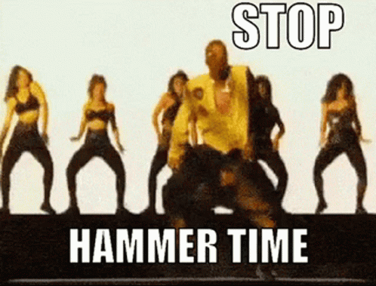
Azure Data API Builder
DEMO

